Slide 1
IBM x Columbia
Weekly Meeting
IBM x Columbia Core Team
10/1/2025

Slide 2
AGENDA
1
2
3
4
5
IBM x Columbia
10 / 2025
Why we're here today
Overview
Timeline
Team Check-in
Outcome Classification
Next Step

Slide 3
Overview
This weekly meeting will be focusing on establishing a clear roadmap and reviewing initial progress for the IBM x Columbia project. Including the timeline, team check-in, and some Q&A at the end.

Slide 4
Timeline
We listed the most critical to-do steps in the project in a summary paragraph. And create a 10 week timeline, estimating how long it will take to do them.

Slide 5
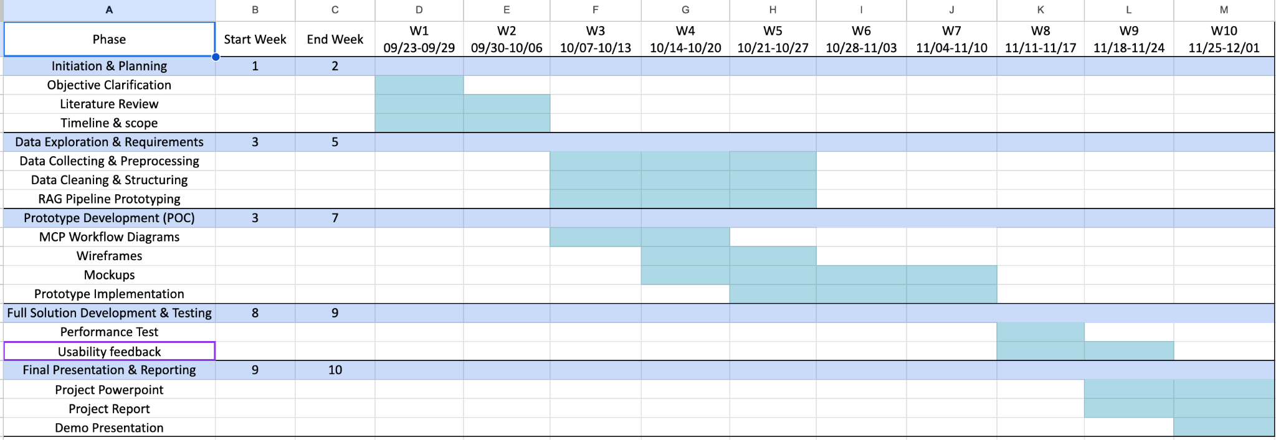
Timeline

Slide 6
Team Check-in
What have each team done this week?

Slide 7
Team Check-in
Domain & Requirements Team
Data & Knowledge Engineering Team
Generative AI & Model Development Team
User Experience & Application Development Team
Evaluation & Compliance Team

Slide 8
Domain & Requirement Team
Focus on Four Key EPLC Phases：
Concentrated on Requirements Analysis, Design, Development, and Implementation, ensuring clear understanding of each phase’s objectives, deliverables, and workflows.
Conducted documentation research related to EPLC,
Analyzed the required documents and workflows of the EPLC process, and identified existing pain points and issues.
Assigned specific tasks to team members based on their expertise, including documentation structure and workflow mapping.

Slide 9
Data & Knowledge Engineering Team
Clarifying EPLC and RAG to the subteam members, Assign tasks to subteam members and allocate roles based on their individual strengths and skills, such as data cleaning, structuring documents, or building RAG pipelines.
Going through the HHS EPLC Website and CDC UP Templates to get a better understanding of the datasets we’ll be working with, and reviewing the templates of the four key EPLC phases (Requirement Analysis, Design, Development, Implementation).
Setting up and using a GitHub co-working platform for code sharing and team collaboration

Slide 10
GenAI & Model Development
Studied 10 key phases of EPLC and identified the required deliverables.
Research concepts of the Retrieval-Augmented Generation
EPLC Chatbot that integrates ChatGPT-3.5 API with a RAG pipeline
Technical Architecture (concept):
Data layer: Processed EPLC documents stored in a vector database
Retrieval layer: Embedding-based search to retrieve relevant chunks
LLM layer: GPT-3.5 API for generation (answers, drafts, compliance checks)

Slide 11
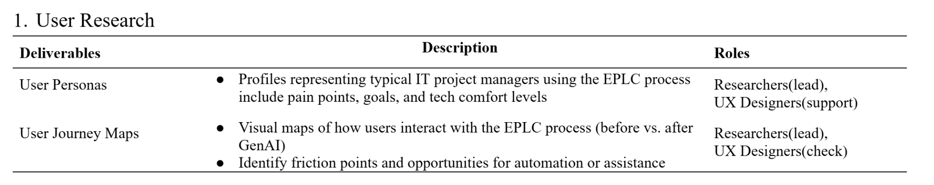
User Experience & Application Development Team
Set Up Shared Workspace
(https://www.notion.so/2025-UX-27cd731e3dce803890f5caeab9eda3d0?source=copy_link)
Draft Initial User Personas
Key deliverables & roles clarification
User Journey Maps in progress

Slide 12
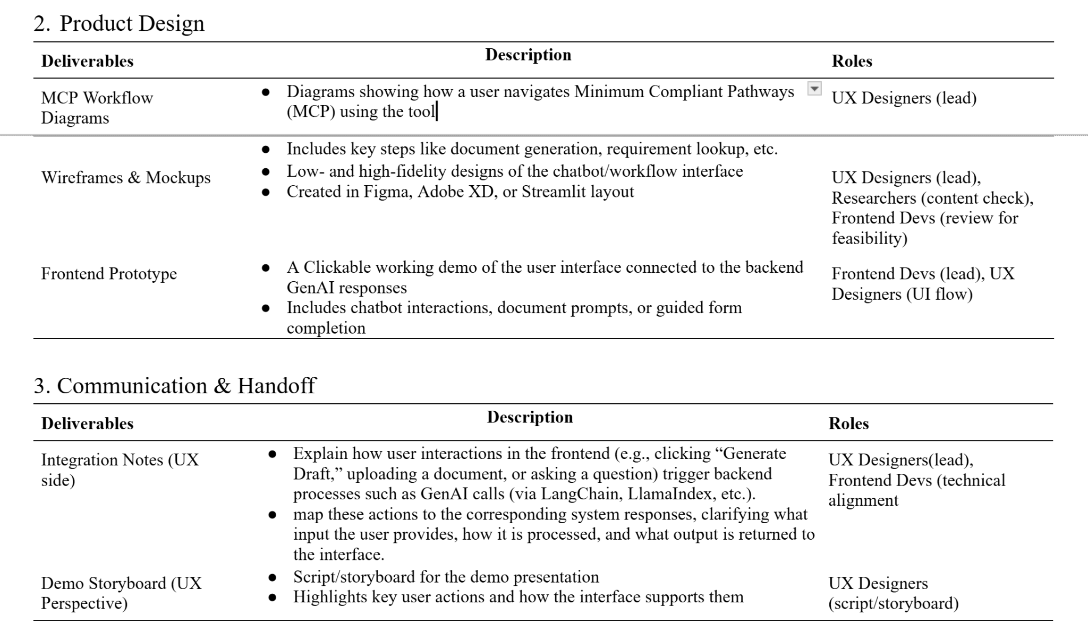
User Experience & Application Development Team

Slide 13
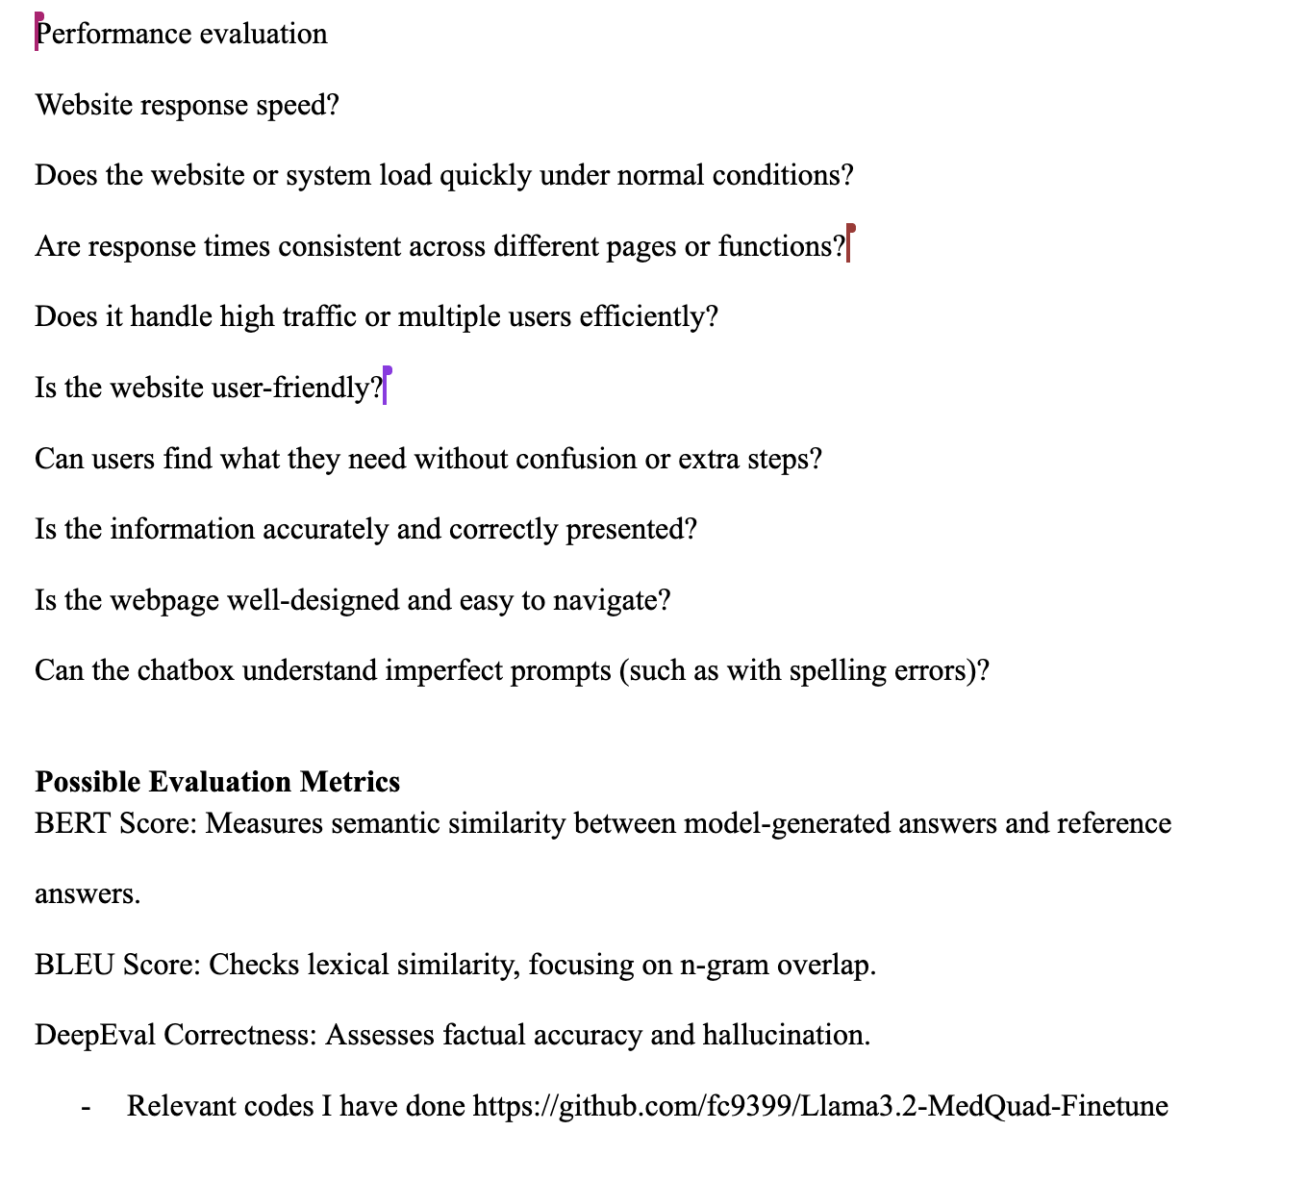
Evaluation & Compliance Team
For evaluation, we have identified key performance considerations such as response speed, consistency across functions, user-friendliness, and the ability to handle high traffic.
Since we have not yet finalized whether the output will take the form of a chatbot or a file-helper system, we will further refine and tailor these metrics as the project direction becomes clearer.

Slide 14
Outcome Clarification
Q: Key focus among functions → Q&A, drafting, compliance?
Q: Should we filter the policies to focus on IT Project Managers as our primary users, or should we extract all policies across all roles?

Slide 15

NEXT
STEPS
Keep up with the timeline, communicate with the sub-team for better support. Diving into the topics we’ve touched on today to deepen our understanding on the project, and starting the data preparation procedure.

Slide 16
THANK
YOU!
IBM x Columbia
10 / 2025
Columbia Practicum Core Team

